Slide 1
TOPIC 3 Normative theories:
References:
Deegan, C, 2010, Financial Accounting, Ch. 2

Slide 2
Learning objectives/outcomes
Define normative theories
Explain normative theory development
Explain the function of the AASB framework
Explain the components of the AASB framework and how they are connected

Slide 3

Normative theory development:
Example
Objective: to meet a friend in Geelong café at 2pm. Cafe is a 5 minute walk from train station
Assumptions/propositions?
Conclusion: catch the 12.50 Geelong train
What assumptions have been made to arrive at this conclusion? What if your assumptions are incorrect?

Slide 4

Normative accounting theories:
Prescriptive ie. what should be
Conclusions are logically derived from assumptions (normally based on real-life observations; may or may not be true),
and objectives
If assumptions not true conclusions (principles/practice) may be invalid
Examples: Current value systems; conceptual framework!!
Let us look at the process of developing a normative accounting theory
Notes:
Prescriptive:
• Marx - how society should work
• Adam smith - repetition - increased productivity

Slide 5

Normative accounting theory development process
Objective: to provide financial information, which is useful as a basis for action, to those who have an interest in a company, and who do not have the power to demand specific information (note: there are other possible objectives)
What assumptions are we making, and/or going to have to make in order to develop a framework based on the objective?

Slide 6
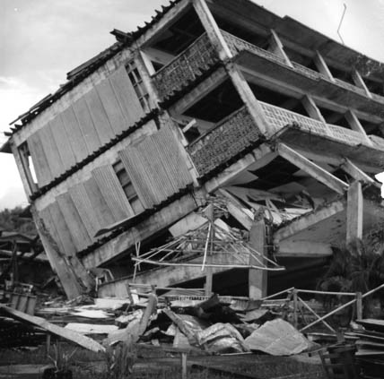
We will now look at a normative theories which form the basis of accounting practice ...

Slide 7
1. AASB Framework (CF)
The ‘theory’ (set of ideas which should be logically connected) which forms the basis for existing accounting practice
argued by accounting regulators to be a normative theory, however, it is largely based on practice
The framework consists of the following …

Slide 8
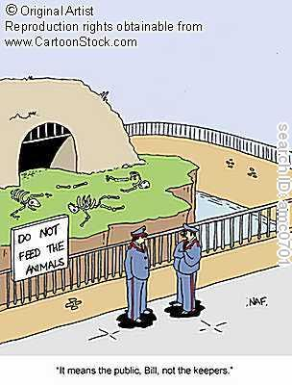
SAC1 ‘Reporting entity’:
entities with external users who are dependent on general purpose financial reports for making and evaluating resource allocation decisions should produce ‘general purpose financial statements’

Slide 9
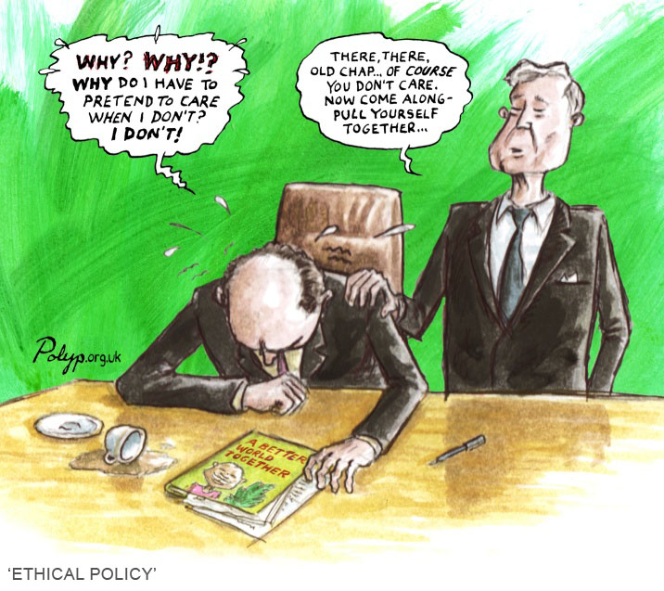
SAC2 ‘Objective of general purpose financial reporting’
Provide appropriate information for making and evaluating resource allocation decisions, and
To discharge accountability

Slide 10

Objective of general purpose financial reporting cont.
Financial position
  Resources controlled
  Financial structure
  Liquidity and solvency
  Capacity to adapt
Financial performance
  Capacity to generate cash
  Effectiveness in using resources
Cash flow
  Sources
  Capacity to generate cash

Slide 11
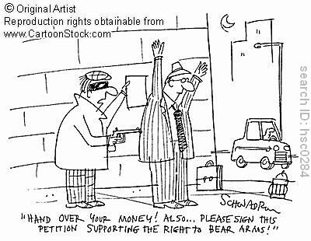
‘Qualitative characteristics’
Relevance
  Capacity to influence decisions

Slide 12
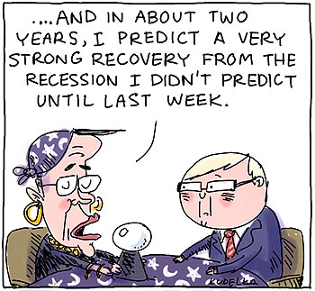
‘Qualitative characteristics’ cont.
Reliability
  accuracy or trustworthiness
Faithful representation
Substance over form
Neutrality
  Free from bias
completeness

Slide 13
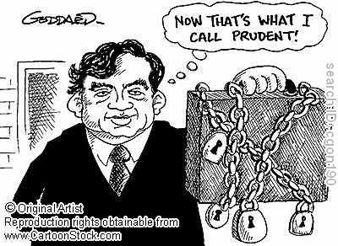
‘Qualitative characteristics’ cont.
Prudence
  Inclusion of a degree of caution in the preparation of financial reports

Slide 14
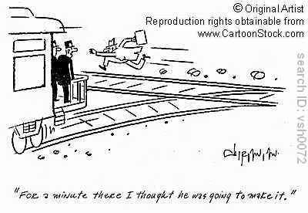
‘Qualitative characteristics’ cont.
Timeliness

Slide 15

‘Qualitative characteristics’ cont.
Understandability
  Users assumed to have a reasonable understanding of business, economic activities and accounting

Slide 16

‘Elements of financial statements’
Assets, liabilities, revenues, expenses, owners equity – we will look at definitions in later topics…
Earlier version described as “verbal diarrhoea strung together in incomprehensible jargon” (The Age, 18 May, 1993). Withdrawn due to lobbying and reissued with some changes

Slide 17

Measurement
“A number of different measurement bases are employed to different degrees and in varying combinations in financial reports, including the following…

Slide 18
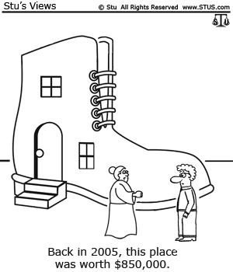
Measurement cont.
Historic cost
  Amount paid
Current cost
Realisable value
  Selling price in normal course of business
Present value
  Discounted value of future net cash inflows

Slide 19
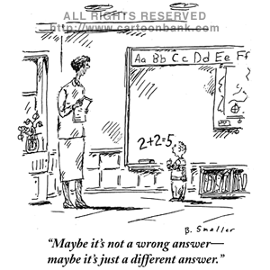

Slide 20
Measurement: relevance
Let is consider the relevance of different financial measures of resources:
  cost, and depreciated cost are not relevant to assessment of liquidity, solvency, financial flexibility or capacity to generate cash in the future
  exchange value is relevant to assessment of financial flexibility and capacity to pay debts-indicator of capacity to generate cash through sale
  value in use (cash flows expected to be generated through use) is relevant to assessment of capacity to pay dividends and debts in the future, HOWEVER this value is highly subjective…
  Current cost – relevant to replacement
  Is it the accountant’s role to predict what might be?

Slide 21

Measurement: reliability!

Slide 22
Measurement: reliability
Some types of measurements are more reliable than others:
‘Fundamental’ measurements:
  bear a direct relationship to attribute measured; can be directly observed
  Objective/verifiable
  Examples?
‘Derived’ measurements: derived from one or more fundamental measures
  Objective/verifiable
  Examples?
‘Fiat’ measurements: measure arbitrarily determined and mandated
  Subjective; cannot be directly observed
  Examples? Taxable income

Slide 23
Discuss the reliability of the following measurements
The height of the desk is 60 centimetres
The money in my wallet adds up to $30.50
If I have $20 in my purse and I buy a bag of apples for $4 I have $16 left
Amortisation of Intangible assets $50,000 (identifiable assets with an indefinite useful life must be expensed/written off over that life)
Depreciation is $12,000 calculated using the straight line method

Slide 24
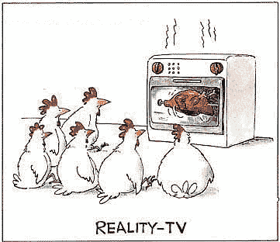
Validity of theory?
Validity depends on how well theory explains or reflects reality eg. validity of assumptions; internal consistency
  historic cost accounting assumes the value of the dollar remains constant!
Framework does not provide a logically consistent set of ideas which lead to conclusions about measurement!!

